Slide 1
Data Structures
_{Lecture 9: Heap}

Slide 2
Array Representation
Number the nodes using the numbering scheme for a complete binary tree. The node that is numbered i is stored in tree[i].
0
a
1
2
b
c
3
4
5
5
d
e
f
g
7
8
9
h
i
j
tree[10]=
a
b
c
d
e
f
g
h
i
j
0 1 2 3
4 5 6 7 8
9

Slide 3
An array implementation of a Complete Binary Tree:
Number the nodes (starting at 0) by levels, from top to bottom and left to right within level
0
1
2
3
4
5
6
Parent to children (index i to 2i+1, 2i+2)
0 1 2 3 4 5 6 ……
Root
Level 1 nodes
Level 2 nodes

Slide 4
Complete Binary Tree Representations
If a complete binary tree with n nodes is represented sequentially, then for any node with index i, 0<=i<=n-1, we have:
parent(i) is at ⎣(i-1)/2⎦ if i!=0.
If i=0, i is at the root and has no parent.
leftChild(i) is at 2i+1 if 2i+1<n.
If 2i+1>=n, then i has no left child.
rightChild(i) is at 2i+2 if 2i+2 <n.
If 2i +2>n, then i has no right child.
Parent of child i

Slide 5
Heap
Definition:
A heap is a binary tree with the following conditions:
it is essentially complete: all its levels are full, except last level where only some rightmost leaves may be missing
The key at each node is ≥ keys at its children

Slide 6
Example
a heap
not a heap
not a heap
Note: Heap’s elements are ordered top down (along any path down from its root), but they are not ordered from left to right

Slide 7
The Heap Data Structure
Def: A heap is a complete binary tree
with the following two properties:
Structural property: all levels are full, except possibly the last one, which is filled from left to right
Order (heap) property: for any node x
Parent(x) ≥ x
8
It doesn‘t matter that 4 in level 1 is smaller than 5 in level 2
7
4
5
2
Heap (top to bottom and left to right)

Slide 8
Heap Types
Max-heaps (largest element at root), have the max-heap property:
for all nodes, excluding the root:
PARENT ≥ child
Min-heaps (smallest element at root), have the min-heap property:
for all nodes , excluding the root:
PARENT ≤ child

Slide 9
7
1
5
5
2
5
4
2
4
3
4
5
6
7
Max-heaps
Min-heaps

Slide 10
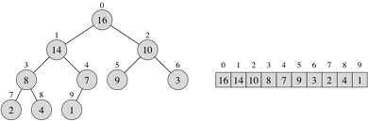
Heap as an array
Parent of left Child right Child
index index index
i 2i+1 2i+2
⎣(i-1)/2⎦ i
Notes:
Heap Algorithms
Parent(A, i)
/ Input: A: an array representing a heap, i: an array index / Output: The index in A of the parent of i / Running Time: O(1)
1 if i == 1 return NULL
2 return ⌊i/2⌋
Left(A, i)
/ Input: A: an array representing a heap, i: an array index / Output: The index in A of the left child of i / Running Time: O(1)
if 2 ∗ i ≤ heap-size[A]
return 2 ∗ I
else return NULL
Right(A, i)
/ Input: A: an array representing a heap, i: an array index / Output: The index in A of the right child of i / Running Time: O(1)
if2∗i+1≤heap-size[A]
return 2∗i+1
else return NULL
Max-Heapify(A, i)
/ Input: A: an array where the left and right children of i root heaps (but i may not), i: an array index / Output: A modified so that i roots a heap / Running Time: O(log n) where n = heap-size[A] − I
l ← Left(i)
r ← Right(i)
if l ≤ heap-size[A] and A[l] > A[i]
largest ← l
else largest ← I
if r ≤ heap-size[A] and A[r] < A[largest]
largest ← r
if largest ̸= I
exchange A[i] and A[largest]
Max-Heapify(A, largest)
Build-Max-Heap(A)
/ Input: A: an (unsorted) array / Output: A modified to represent a heap. / Running Time: O(n) where n = length[A]
heap-size[A] ← length[A]
for i ← ⌊length[A]/2⌋ downto 1
Max-Heapify(A, i)

Slide 11
Operations on Heaps
Maintain the max-heap property
MAX-HEAPIFY
Create a max-heap from an unordered array
BUILD-MAX-HEAP
Sort an heap array
HEAPSORT

Slide 12
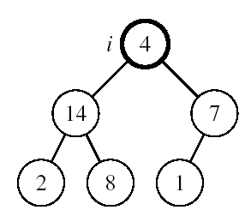
Maintaining the Heap Property
When:
Left and Right subtrees of i are max-heaps and A[i] breaks the heap property if A[i] may be smaller than its children
How to return on heap?
Compare i^{th} value with it’s left and right child key value to find the largest one.
If Largest value is in largest_index
And If the largest_index is not equal to I, i.e. largest value is not in i^{th} position then exchange the i^{th} value with largest value.
And repeat the recursive procedure for largest_index instead of i.

Slide 13
MAX-HEAPIFY(A, i, n)
LEFT_child = 2i+1
RIGHT_child =2i+2
If LEFT_child < n and A[LEFT_child] > A[i]
then largest_index = LEFT_child
else largest_index = i
If RIGHT_child < n and A[RIGHT_child] > A[largest_index]
then largest_index = RIGHT_child
if largest_index ≠ i
then exchange A[i] ↔ A[largest_index]
MAX-HEAPIFY(A, largest_index, n)

Slide 14
Initializing A Max Heap
4
14
7
2
8
1
Find the position (home) for 4.

Slide 15
Initializing A Max Heap
14
7
2
8
1
Find home for 1.

Slide 16
Initializing A Max Heap
14
8
7
2
1
Find home for 1.

Slide 17
Initializing A Max Heap
14
8
7
2
4
1
Done.

Slide 18
Building a Heap
Convert an array A[0 … n-1] into a max-heap
when, n = length of A[] = number of element
The elements in the sub-array A[⎣n/2⎦] …… A[n-1] are leaves
Apply MAX-HEAPIFY on elements among A[(⎣n/2⎦-1)] to A[0]
0
4
Alg: BUILD-MAX-HEAP(A)
n = length of A[]
for i = ⎣(n-1)/2⎦ down to 0
do MAX-HEAPIFY(A, i, n)
1
2
1
3
3
4
5
6
2
16
9
10
7
8
9
14
8
7
A:
4 | 1 | 3 | 2 | 16 | 9 | 10 | 14 | 8 | 7

Slide 19
Building A Max Heap
1
2
3
4
5
6
7
8
9
7
11
7
8
10
input array = [1, 2, 3, 4, 5, 6, 7, 8, 9, 10, 11]

Slide 20
Initializing A Max Heap
1
2
3
4
5
6
7
8
9
7
11
7
8
10
Start at rightmost node that has a child i.e. last parent.
Index is (⎣n/2⎦-1) .

Slide 21
Initializing A Max Heap
1
2
3
4
11
6
7
8
9
7
5
7
8
10
Move to next lower array position. Repeat it up to root.

Slide 22
Initializing A Max Heap
1
2
3
4
11
6
7
8
9
7
5
7
8
10

Slide 23
Initializing A Max Heap
1
2
3
9
11
6
7
8
4
7
5
7
8
10

Slide 24
Initializing A Max Heap
1
2
3
9
11
6
7
8
4
7
5
7
8
10

Slide 25
Initializing A Max Heap
1
2
7
9
11
6
3
8
4
7
5
7
8
10

Slide 26
Initializing A Max Heap
1
2
7
9
11
6
3
8
4
7
5
7
8
10

Slide 27
Initializing A Max Heap
1
11
7
9
6
3
8
4
7
5
7
8
10
Find a home for 2.

Slide 28
Initializing A Max Heap
1
11
7
9
10
6
3
8
4
8
7
7
5
Find a home for 2.

Slide 29
Initializing A Max Heap
1
11
7
9
10
6
3
8
4
7
7
8
2
5
Done, move to next lower array position.

Slide 30
Initializing A Max Heap
1
11
7
9
10
6
3
8
4
2
7
7
8
5
Find home for 1.

Slide 31
Initializing A Max Heap
11
7
9
10
6
3
8
4
2
7
7
8
5
Find home for 1.

Slide 32
Initializing A Max Heap
11
10
7
9
6
3
8
4
2
7
7
8
5
Find home for 1.

Slide 33
Initializing A Max Heap
11
10
7
9
5
6
3
8
4
2
7
7
8
Find home for 1.

Slide 34
Initializing A Max Heap
11
10
7
9
5
6
3
8
4
2
7
7
8
1
Done.

Slide 35
Exercise: Arrange this array as a heap tree/Array?
Array
0
5
1
2
4
9
3
4
5
6
7
19
8
17
7
8
9
2
6
5
10
21
Heap array
21 19 17 7 5 8 9 2 6 5 4
0 1 2 3 4 5 6 7 8 9 10

Slide 36
Putting An Element Into A Max Heap
9
8
7
6
7
2
6
5
1
7
Complete binary tree with 10 nodes.

Slide 37
Putting An Element Into A Max Heap
9
8
7
6
7
2
6
5
1
7
5
New element is 5.

Slide 38
Putting An Element Into A Max Heap
9
8
7
6
7
2
6
5
1
7
7
If the new element is 20 rather than 5.

Slide 39
Putting An Element Into A Max Heap
9
8
7
6
2
6
5
1
7
7
7
New element is 20.

Slide 40
Putting An Element Into A Max Heap
9
7
6
8
2
6
5
1
7
7
7
New element is 20.

Slide 41
Putting An Element Into A Max Heap
20
9
7
6
8
2
6
5
1
7
7
7
New element is 20.

Slide 42
Putting An Element Into A Max Heap
20
9
7
6
8
2
6
5
1
7
7
7
Complete binary tree with 11 nodes.

Slide 43
Putting An Element Into A Max Heap
20
9
7
6
8
2
6
5
1
7
7
7
New element is 15.

Slide 44
Putting An Element Into A Max Heap
20
9
7
6
2
6
5
1
7
8
7
8
7
New element is 15.

Slide 45
Putting An Element Into A Max Heap
20
15
7
6
9
2
6
5
1
7
8
7
8
7
New element is 15.

Slide 46
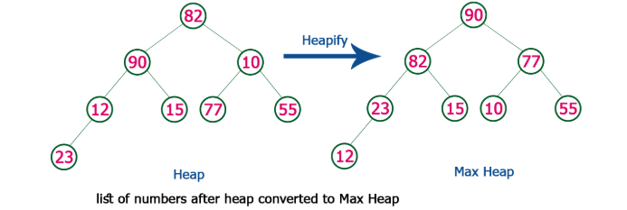
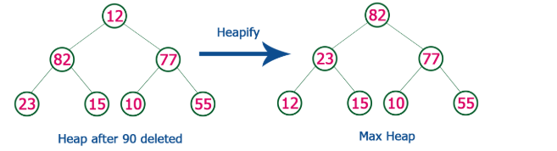
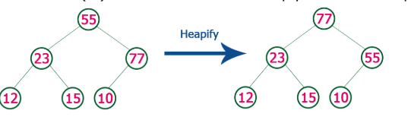
Delete Element from max heap
Repace Root with last node and delete last node

Slide 47
Removal of root: The procedure for deleting the root from the heap (effectively extracting the max/min element in a max-heap or in a min-heap) and restoring the properties is called down-heap (also known as heapify-down, cascade-down and extract-min/max).
Delete
Replace/exchange the root of the heap with the last element on the last level.
Reduce the heap size by one and
Perform the MAX-HEAPIFY(A, 0, n-1 ) function for the root i=0.

Slide 48
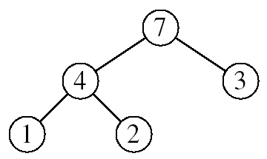
Heapsort
Goal:
Sort an array using heap representations
Idea:
Build a max-heap from the array
Swap the root (the maximum element) with the last element in the array
“Discard” this last node by decreasing the heap size
Call MAX-HEAPIFY on the new root
Repeat this process until only one node remains

Slide 49
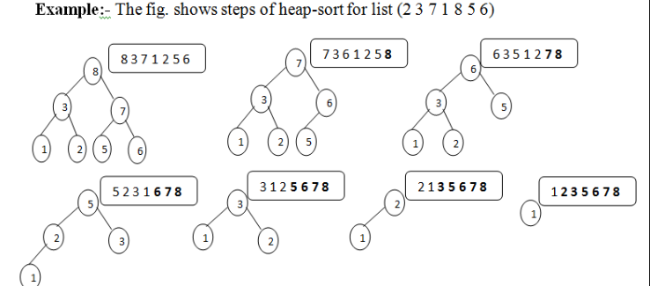
Heapsort
Convert binary tree into max heap

Slide 50
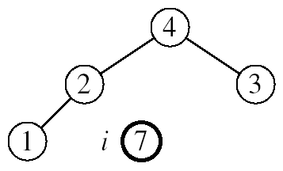
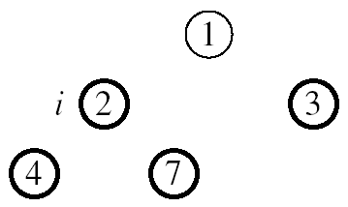
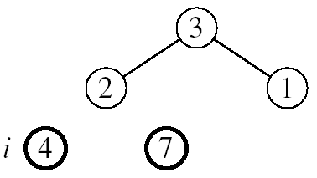
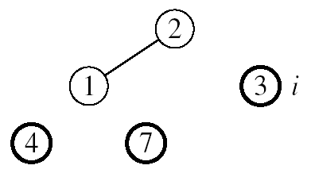

Example: A=[7, 4, 3, 1, 2]
MAX-HEAPIFY(A, 0, 3)
MAX-HEAPIFY(A, 0, 2)
MAX-HEAPIFY(A, 0, 1)

Slide 51
Uses of Heaps
There are two main uses of heaps.
The first is as a way of implementing a special kind of queue, called a priority queue.
The second application is sorting.

Slide 52
To sort an array, or list, containing N values there are two steps:
insert each value into a heap (initially empty)
remove each value form the heap in ascending order (this is done by N successive calls to get_smallest).
What is the complexity of the HeapSort algorithm?
(N insert operations) + (N delete operations)
Each insert and delete operation is O(logN) at the very worst - the heap does not always have all N values in it. So, the complexity is certainly no greater than O(NlogN).

Slide 53
Some Important Properties of a Heap
Given n, there exists a unique binary tree with n nodes that
is essentially complete, with h = ⎣log₂ n⎦
The root contains the largest key
The subtree rooted at any node of a heap is also a heap
A heap can be represented as an array

Slide 54
A Heap is a data structure used to efficiently find the smallest (or largest) element in a set.
Min-heaps make it easy to find the smallest element.Max-heaps make it easy to find the largest element.
Heaps are based upon trees. These trees maintain the heap property.
The Heap invariant. The value of Every Child is greater than the value of the parent. We are describing Min-heaps here (Use less than for Max-heaps).
The trees must be mostly balanced for the costs listed below to hold.
Access to elements of a heap usually have the following costs.
The cost to find the smallest (largest) element takes constant time.
The cost to delete the smallest (largets) element takes time proportional to the log of the number of elements in the set.
The cost to add a new element takes time proportional to the log of the number of elements in the set.

